Slide 1


EduVerse
A Personalized Learning Platform
Vishwakarma Institute Of information technology ,Pune (411048)

Slide 2
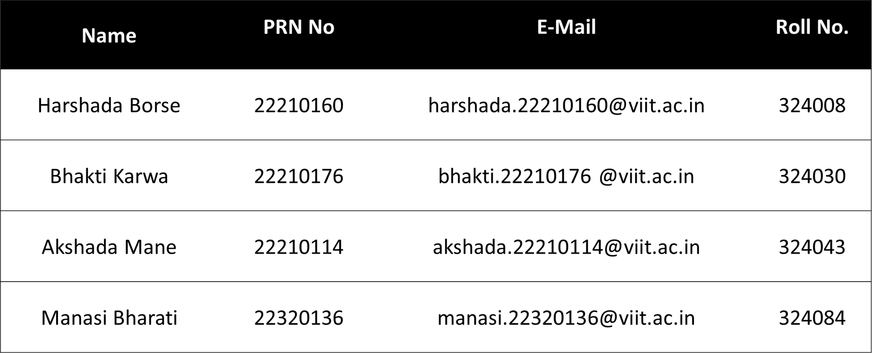
Presented By
Vishwakarma Institute Of information technology ,Pune (411048)

Slide 3

Introduction
EduVerse is a student-centric platform designed to simplify the search for relevant learning resources.
Students can:
Get book recommendations by entering the book name and author.
Receive Udemy course recommendations when searching by subject.
Get personalized career guidance based on machine learning models.
By leveraging intelligent recommendation systems, EduVerse saves time and helps students focus on learning.

Slide 4


To provide tailored book recommendations based on user input (book name, author).
Objectives
To offer relevant Udemy course suggestions based on the subject search.
Key Goals of EduVerse:
To deliver personalized career recommendations using machine learning algorithms.
To Create a seamless learning experience by integrating book and course recommendations in one platform

Slide 5


Technology Stack & Datasets
Frontend
Backend :
Machine Learning Algorithms:
Datasets :
HTML
CSS
JavaScript
jQuery
Bootstrap
Backend
Python( Flask )
Popularity-Based Model
Collaborative Filtering
Cosine Similarity
ML algorithms like Logistic Regression ,Support Vector Classifier (SVC) , Random Forest Classifier ,XGBoost
student-scores.csv -->(2000, 15)
udemy_courses.csv -->(3683, 18)
Books.csv -->
(271360,8)
Users.csv --> (278858,3)
Rating.csv -->(1149780,3)

Slide 6
Key Features
Course Recommendation
System:
Career Recommendation
System:
Book Recommendation System:
Cosine Similarity-Based Recommendations
Uses Cosine Similarity to measure the relevance between subjects and suggest the most suitable Udemy courses.
2. Udemy Course Redirection
Redirects students to Udemy for detailed course information and enrollment options.
Feature Engineering:
Utilizes students' subject scores, extracurricular activities, and other profile data, transformed into numeric features, to enhance the recommendation accuracy.
2.Machine Learning Models
Implements various models like Logistic Regression, Random Forest, and XGBoost, providing personalized career advice by identifying patterns in student preferences and skill sets.
Popularity-Based Model:
Books are recommended based on their average ratings and the number of ratings.
Ensures that well-rated and popular books are suggested, improving user satisfaction.
2. Collaborative Filtering:
Identifies patterns in users' preferences by finding similarities among users.
This approach suggests books based on how similar users have interacted with them.

Slide 7
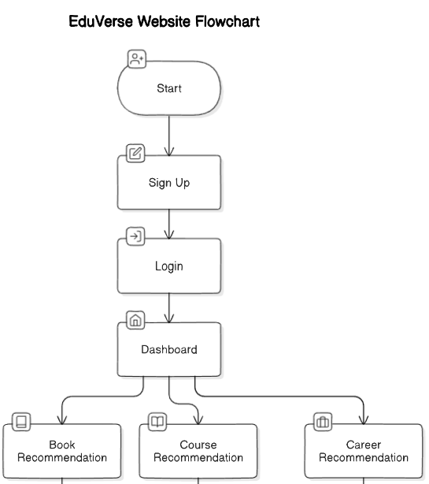
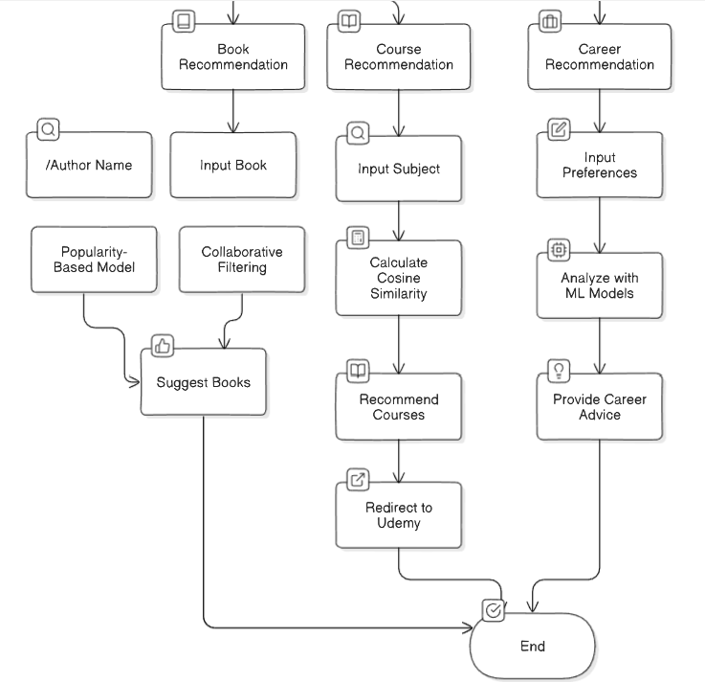

Slide 8
Future Enhancements
Expand Learning Resources:
Incorporate additional resources such as video tutorials, research papers, or podcasts.
Improved Personalization:
Use deeper machine learning models for even more accurate career recommendations.
Multilingual Support:
Enable students to search for courses and books in multiple languages.
Gamification:
Introduce gamified elements like achievement badges to motivate learning.

Slide 9
Conclusion
EduVerse streamlines the learning journey for students by offering personalized book, course, and career recommendations.
The platform saves time and effort, allowing students to focus on what matters most – learning.
With its machine learning algorithms and seamless integration with Udemy, EduVerse enhances the educational experience, making it easier for students to access valuable resources and make informed decisions about their careers.

Slide 10


THANK YOU

